Slide 1

Advanced Software Engineering CSE608
A Case study of a Library System
Dr. Islam El-Maddah

Slide 2
Problem description
students can go to the library front office with the book they need to borrow scan it and scan their IDs then the system add the book to them and show them message when to return the book
The student when returning the book simply scan the book copy and the system set the copy as free again and someone will manually move it back to its normal shelf

Slide 3




Problem description
The student can also search for books by title or by category and the system list all related books.
If some book is not available for borrowing the student can reserve it and when any copy of it return the library system notify the student of the book arrival so he can borrow it.
The admin can add or remove books as well as add and remove book copies
The history of student borrowed books as well as the history of the book copy need to be stored until last three years

Slide 4

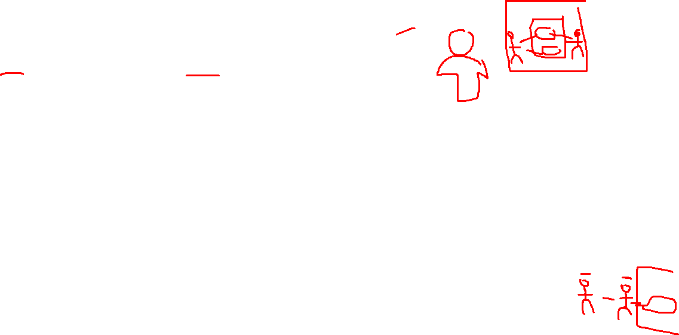
Stakeholder meeting
Students should be notified of books due
personal data should be covered
Our system must be reliable and allow online access
During exams I cannot find copies to borrow
Sometimes I need to add new books and new copies
Need to limit number of book borrowed
I need to know borrow history for students

Slide 5
Sample user stories
As a student I need to find the books quickly so I can save my time
The student search for a book using author name, book title and the result is retrieved within 30 seconds maximum
As a student I need search for books quickly from home, so that I can quickly borrow them
The student search for a book using author name, book title and the result is retrieved within 2 minutes maximum
As a library admin I need to encourage borrowing books, so I can maximize the benefit for the uni and library
EPIC Story
As a library admin I need to keep all data secured so that I maximize the student privacy
This is non functional requirement can be used as restriction for all user stories with student data to encrypt them

Slide 6


Use Case Diagram
admin
See student history
remove book
Borrow book copy
See book copy history
add book
Reserve book
clerk
student
Search books
add book copy
Return book copy
housekeeping
remove book copy
Time

Slide 7

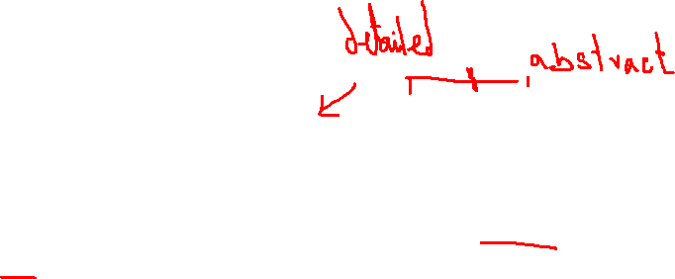


Search Use Case description
Search books |  | Use case
student |  | Actor
Student needs to look for books |  | trigger
System is running student is logged in |  | Pre condition
Student see the selected book list |  | Post condition
Category name |  | input
none |  | output
Enters the category name | 1 Actor | Main course
Accept the category name | 2 System
Press search | 3 Actor
Looks for books with this category and display their details and number of copies available | 4 System
Observe the result and terminate the search form (OK button) | 5 Actor
Ends the dialog and return control to the actor again | 6 System
1.1 category name is wrong or empty book list, the system send s a message and ask the actor to retype category name |  | alternative

Slide 8


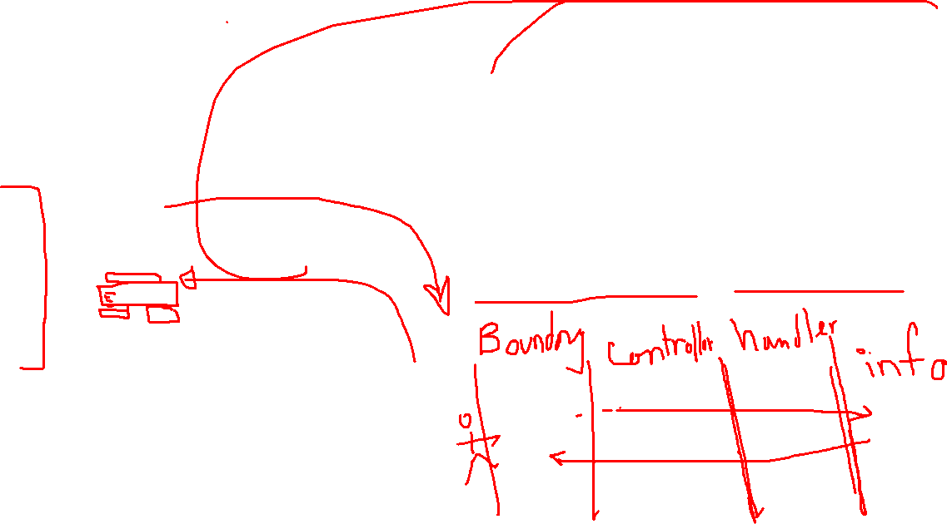
Analysis class for search
search form
Search controller
Category
Book
Copy

Slide 9
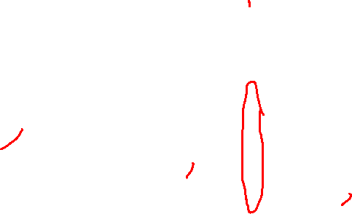
Time Sequence Diagram for search
:search form
:Search controller
:Category
:Book
:Copy
Search
after adding category keyword
Search_by_category(cat)
Get_allrelated_books()
Get_book_details()
Get_number_ofcopies()
many
many
IS_COPY()

Slide 10
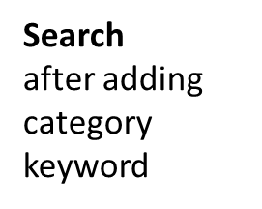

Accommodating messages from the sequence diagram
:search form
:Search controller
:Category
:Book
:Copy
Search_by_category(cat)
Get_allrelated_books()
Get_book_details()
Search
after adding category keyword
Get_number_ofcopies()
Search_by_category(cat)
Get_allrelated_books()
Get_book_details()
Get_number_ofcopies()
IS_COPY()

Slide 11

Analysis classes for borrow
Borrow form
Borrow controller
student
To keep time of borrow return, history copy record is needed similarly reserve record
Book
Copy
Copy record

Slide 12

Collaboration diagram borrow
1. Borrow ()
1.2 count_copies_onloan ()
1.1 Borrow ( sid, cid)
:Borrow form
:Borrow controller
1.3 how_many()
1.5 check_for_borrw ()
1.6 create ()
student
Copy
Copy record
1.4 has* ()

Slide 13


Accommodating the methods/messages in the analysis classes
:Borrow form
:Borrow controller
1. Borrow ()
1.1 Borrow ( sid, cid)
1.2 count_copies_onloan ()
:student
:Copy
1.5 check_for_borrw ()
1.3 how_many()
:Copy record
1.6 create ()
1.4 has* ()

Slide 14

Unify classes !! Unify class methods
Book_copy and copy are the same class etc.

Slide 15


Borrow scenario may end up either happy ☺ or unhappy if the student has many books on loan ☹ or the copy is not correctly understood as free ☹

Slide 16

Create() is the simple new in C++ or java
Delete is delete

Slide 17
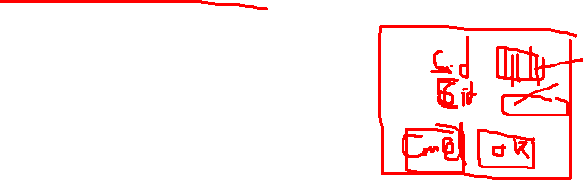
Borrow in the form means it is a button or a menu item that is accessed /clicked by the actor

Slide 18
The CTRL takes its parameter from the dialog box thus it knows which object (student and copy) it will access so the parameter journey stops at the CTRL

Slide 19
The CTRL takes the computed values to decide whether we can do the borrow or not according to the copy type and number of copies on loan with the student

Slide 20
CRUD Matrix
A double check between the use case model (what needs to be done) and the structure model/classes (how it will be done)
It may reveal missing use cases or missing classes for use cases which updates the system state

Slide 21
CRUD Matrix
It can also help grouping related classes and use cases, for example use cases that access class students and book or copy and borrow record, etc. this helps while developing the use cases
We will keep an eye on classes with no D, C or U/R
Also will be looking for updating use cases who never issue D,C,U !
And will be looking for reading use cases who does D,C, U !

Slide 22
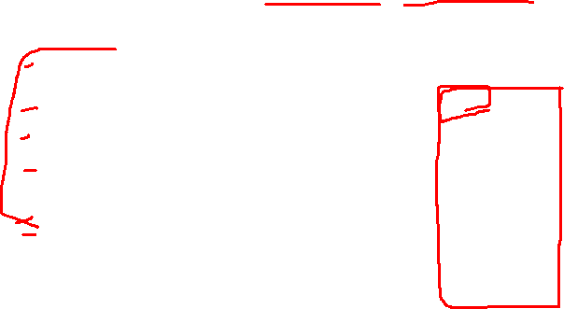
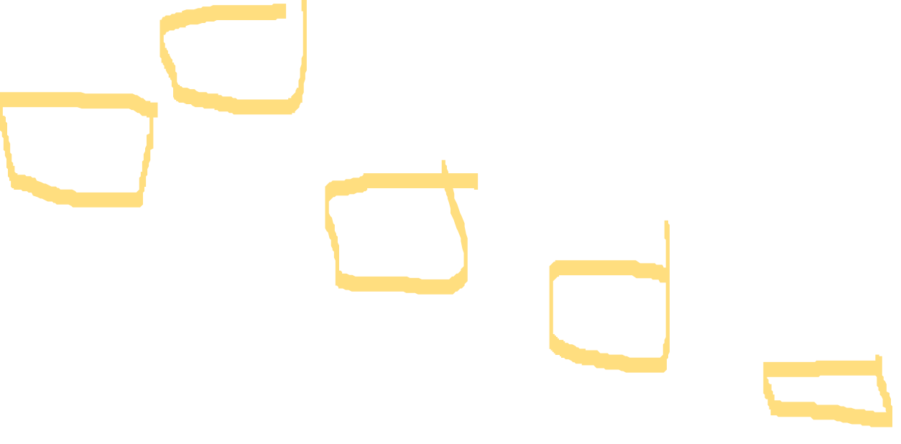
CRUD (Create/ Read/ Update/ Delete)
housekeeping | reserve | return | search | borrow | V class Use case →
 | R |  |  | R | Student
 | R |  | R* |  | Book
 |  |  | R |  | Category
 |  | R | R* | R | Book_copy
D* |  | U | R* | R*/C | Borrow_record
 |  |  | C/R/U/D |  | Search_form
 |  |  | C/R/U/D |  | Search_ctrl
 |  |  |  | C/R/U/D | Borrow_form
 |  |  |  | C/R/U/D | Borrow_Ctrl
 |  | C/R/U/D |  |  | Return_form
 |  | C/R/U/D |  |  | Return_ctrl
 | C/R/U/D |  |  |  | Reserve_form
 | C/R/U/D |  |  |  | Reserve_ctrl
C/R/U/D |  |  |  |  | INT_Handler (boundary)

Slide 23
Need to unify class after these collaboration or sequence diagrams
Missing class for reserve could be reserve record between classes student and book
Need to be linked with return use case so when any one return a reserved book we can send notification to people who stands in a queue (FIFO) most of the time

Slide 24
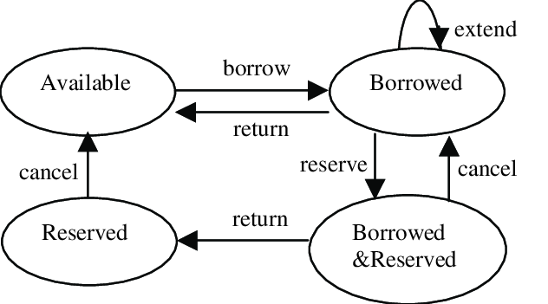





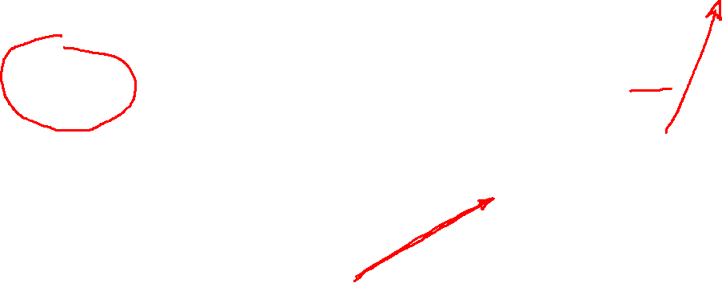



State Transition Diagram
Sent as gift
null
Buy & register
null

Slide 25
Non-functional Requirements
Possible solutions | priority | Affected use cases | description | Non-functional requirement | Category of non-functional requirement | number
Add login process and access control/ use cipher to hide info | High | All those who read/access student data | Information will not be revealed to others | security | (1) quality | 1
Add indexes when possible and enhance search algorithms | High | All use cases | All system functions will be done in limited time | Performance | (1) quality | 2
System will be replicated in another server | medium | All use cases | System will not failed more than once a month | reliability | (1) quality | 3
 |  |  |  |  |  | 4
 |  |  |  |  |  | 5

